Slide 1






TRANSFORMING URBAN TRANSPORTATION SYSTEM
SMART AI Traffic Management
system
DEVELOPMENT ROAD MAP

Slide 2

Smart Traffic Lights
Traffic Managers Dashboard
AI Analysis Models
Remotely controlled, AI-driven traffic lights that adapt signal timing in real-time based on live camera feeds, sensor data, and traffic flow patterns at intersections.
An interactive, web-based dashboard (Next.js) that allows traffic managers to monitor live camera feeds, view traffic congestion levels, detect incidents, and receive AI-generated predictions.
These models generate automatic insights, such as peak traffic times, route optimization suggestions, and anomaly detection.
Key Components of Smart Traffic Management

Slide 3




Timeline
1 .Planning & Requirement Analysis
Define system objectives, needs & scope.
✔️ Problem Identification: Traffic congestion, accidents.
✔️ System Goals: Real-time AI traffic control, live camera feeds, emergency handling.
✔️ Stakeholders: NTSA, Traffic Police, City Authorities & Smart Cities.
2. System Design
Design the technical architecture & user interface.
✔️ Architecture: Backend (FastAPI), Frontend (React), AI Models, IoT Devices.
✔️ Data Flow: Cameras → AI → Dashboard → Emergency Response.
✔️ Deliverables: System diagrams, UI Wireframes, API Specs.

Slide 4

Timeline
3. Implementation
Build system components & integrate AI models.
✔️ Backend: Data APIs, AI Model endpoints, Notification System.
✔️ Frontend: Dashboard (Live Feeds, Insights, Maps).
✔️ AI Models: Vehicle Detection, Congestion Prediction, Accident Detection.
✔️ IoT: Camera feed connection.
4.Testing & Integration
Validate functionality, performance & integration.
✔️ Unit & System Testing (API, AI models).
✔️ Load & Stress Testing (Simulate traffic data).
✔️ Bug Fixing, Performance Optimization.

Slide 5
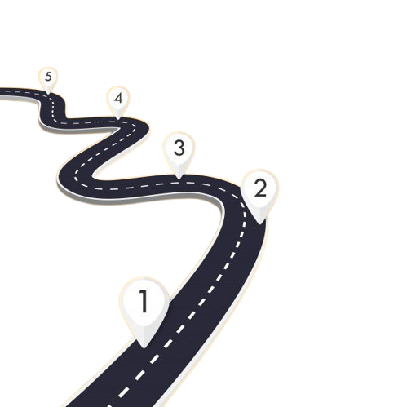
DEVELOPMENT
ROAD
MAP

Slide 6

Week 1 — Road Network & Data Research + API Setup
Understand Kenyan road systems & set up data flow base.
Research Kenyan road structures & traffic laws.
Identify open data sources (Gov, NTSA).
Design system architecture for data ingestion.
Development Task:
Set up backend data ingestion API (Flask/FastAPI) to receive real-time feeds.
Deliverables:
✔️ Kenyan Road Analysis Report
✔️ Backend Data Ingestion API (v1)

Slide 7
Week 2 — Camera Integration Planning + Camera Module Skeleton
Plan camera feed integration & prototype front-end camera component.
Tasks:
Select camera feed standards (RTSP/HTTP).
Plan secure storage & streaming system.
Development Task:
Develop front-end camera module skeleton (Next.js) — placeholder for live video stream.
Deliverables:
✔️ Camera Integration Technical Plan
✔️ React Camera Module (basic frame)

Slide 8
Week 3 — Live Camera Feed Integration + Stream Display
Integrate camera streams into the dashboard.
Tasks:
Connect to IP/CCTV feeds.
Test live streaming (on local/remote dashboard).
Development Task:
Implement live RTSP/HTTP stream player in the dashboard using WebRTC/FFmpeg/Janus Gateway.
Deliverables:
✔️ Functional Camera Stream in Dashboard
✔️ Stream Display & Playback Module

Slide 9
Week 4 — Frame Capture + Data Storage Component
Capture image frames for AI model training.
Tasks:
Implement frame snapshot and save to storage.
Start labeling pipeline for sample images.
Development Task:
Build backend frame capture endpoint (Flask/FastAPI) and connect to storage (local/cloud).
Deliverables:
✔️ Frame Capture Feature
✔️ Labeled Image Dataset

Slide 10
Week 5 — AI Traffic Detection Model + API Endpoint
Develop & train AI models for congestion & vehicle detection.
Tasks:
Train object detection model (YOLOv8/SSD).
Evaluate detection performance.
Development Task:
Expose AI inference results via backend API (FastAPI endpoint) for dashboard consumption.
Deliverables:
✔️ Trained Traffic Detection AI Model
✔️ AI Result API (JSON Response)

Slide 11
Week 6 — Auto-Analysis Model + Dashboard Insights Panel
Auto-generate traffic insights & analysis.
Tasks:
Build AI module for real-time trend analysis.
Automate data labeling (AutoML).
Development Task:
Develop Insights Panel on Dashboard (NextJS) — Display AI-driven traffic summaries & graphs.
Deliverables:
✔️ Auto-Analysis AI Model
✔️ Insights Panel on Dashboard

Slide 12
Week 7 — Accident Detection AI + Emergency Notification Feature
Detect accidents and notify authorities.
Tasks:
Train model to detect sudden stops/crashes.
Simulate accident scenarios for model testing.
Development Task:
Implement auto-notification system (SMS/Email API) for emergency alerts.
Deliverables:
✔️ Accident Detection AI Model
✔️ Emergency Notification Component

Slide 13
Week 8 — System Optimization + Modular Architecture Update
Optimize performance & prepare for scaling.
Tasks:
Optimize latency, stream processing.
Modularize components for scaling.
Development Task:
Refactor backend to microservices structure — Each major feature as a service.
Deliverables:
✔️ Optimized System
✔️ Modular Backend Architecture

Slide 14

"Every great dream begins with a dreamer. To start dreaming your future, close your eyes, envision your goals, and let your imagination guide you on the path toward possibility."
– Iyke Konzolaw

Slide 15
Thank you !!!

